Slide 1

Computer Programming for Engineers
Week 2 Lecture 1
Week 2 Lecture 1
Sep. 6, 2022
Lecturer: Mohammad Mahdi Javidan
College of Engineering, Sungkyunkwan University
Fall Semester 2022

Slide 2
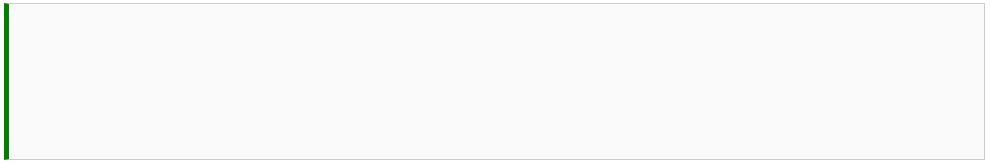

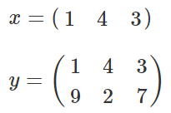






Data Type - numpy
a powerful N-dimensional array object which is important in scientific computing
Finding rows and columns of a matrix and its total size
College of Engineering, Sungkyunkwan University

Slide 3


Data Type - numpy
Increment
Generating a sequence of numbers with a specified increment
Generating a specified number of evenly distributed elements between two numbers
College of Engineering, Sungkyunkwan University

Slide 4








Data Type - numpy
Get the last column of array $y$
College of Engineering, Sungkyunkwan University

Slide 5





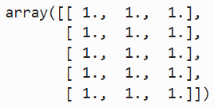

Data Type - numpy
Get the 1st and 3rd column of array $y$
Generating matrices with all the elements as zero
one
College of Engineering, Sungkyunkwan University

Slide 6










Data Type - numpy
Operations on matrices
Element by element multiplication
College of Engineering, Sungkyunkwan University

Slide 7




Data Type - numpy
Transpose of an array
Some numpy in-built mathematical functions
Logical operations on matrices
College of Engineering, Sungkyunkwan University

Slide 8


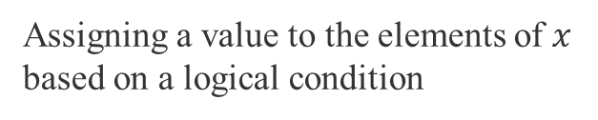
Data Type - numpy
Choosing elements based on a logical condition
Assigning a value to the elements of $x$ based on a logical condition
College of Engineering, Sungkyunkwan University

Slide 9
Assignment 2
Write a line of code that generates the following error:
NameError: name 'x' is not defined
Assign string ‘123’ to the variable S. Convert the string into a float type and assign the output to the variable N. Verify that S is a string and N is a float using the type function.
Use the print function to generate the following strings.
The word ‘Engineering’ has 11 letters.
The word ‘Book’ has 4 letters.
Get the last word ‘great’ from ‘Python is great!’.
Turn ‘Python is great!’ to a list.
Assign list [1, 8, 9, 15] to a variable list_a and insert 2 at index 1 using the insert method. Append 4 to the list_a using the append method.
Get the unique element from (2, 3, 2, 3, 1, 2, 5).
College of Engineering, Sungkyunkwan University

Slide 10
Assignment 2
Assign (2, 3, 2) to set_a, and (1, 2, 3) to set_b. Get the following:
union of set_a and set_b
intersection of set_a and set_b
difference of set_a to set_b
Create a dictionary that has the keys ‘A’, ‘B’, ‘C’ with values ‘a’, ‘b’, ‘c’ individually. Print all the keys in the dictionary.
Let array_a be an array [-1, 0, 1, 2, 0, 3]. Write a command that will return an array consisting of all the elements of array_a that are larger than zero. Hint: Use logical expression as the index of the array.
Create a zero array with size (2, 4) and change the 2nd column in the above array to 1.
Write a cell magic to clear all the variables in the Jupyter notebook
College of Engineering, Sungkyunkwan University

Slide 11
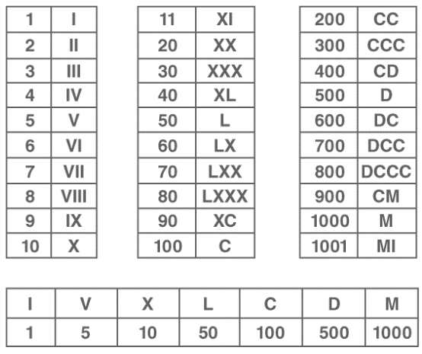
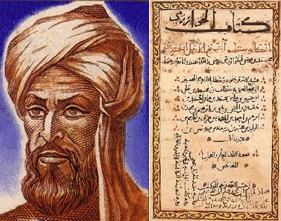
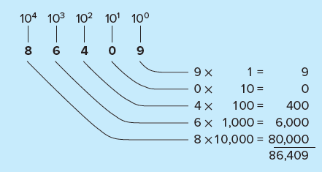
Algorithm & Flowchart
Algorithm: a set of step-by-step rules for solving problems
Roman numerals
Al-Khwarizmi a Persian mathematician, astronomer, and geographer wrote the book “The Hindu Art of Reckoning” in the 9th century
Positional notation
Translated to Latin in the 12th century
Algoritmi de numero Indorum
College of Engineering, Sungkyunkwan University

Slide 12
Algorithm & Flowchart
Algorithm: a step-by-step procedure for solving a problem or accomplishing some end
Flowchart: a diagrammatic representation of an algorithm
Manual operation
Terminator
Process
Decision
Predefined process
Database
Manual input
Flowline
College of Engineering, Sungkyunkwan University

Slide 13
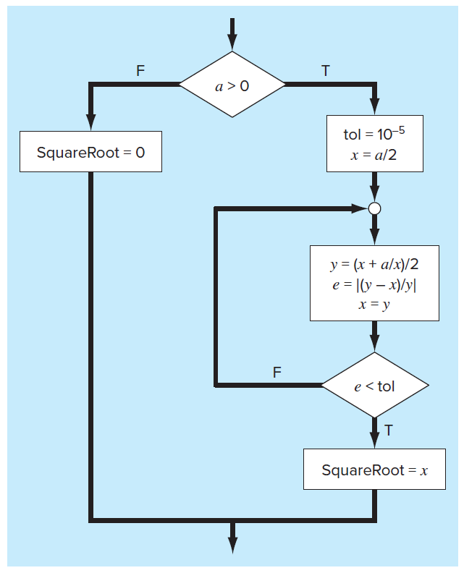
Algorithm & Flowchart
Start
End
College of Engineering, Sungkyunkwan University

Slide 14
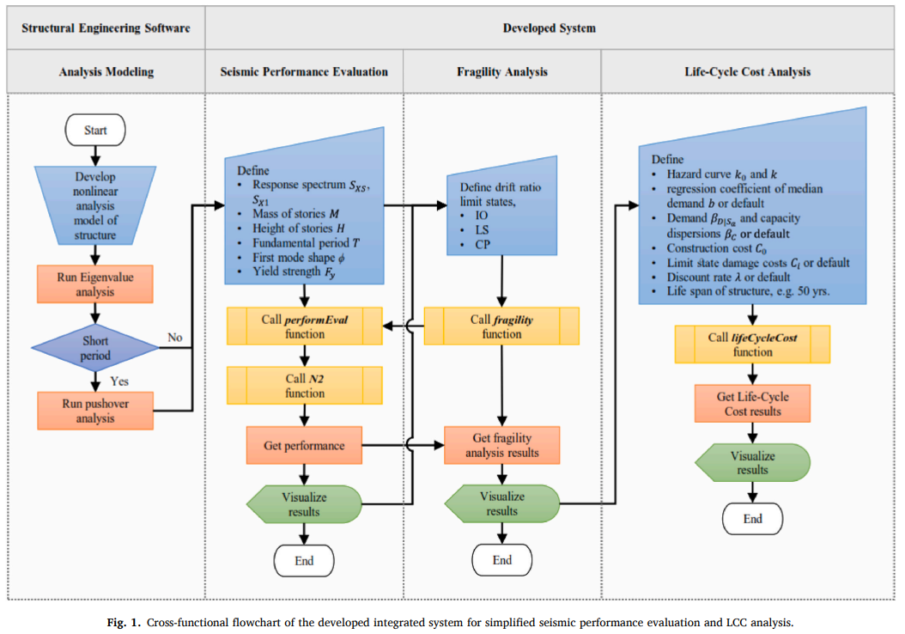
Algorithm & Flowchart
Cross-functional flowchart
Source: Javidan & Kim (2022) “An integrated system for simplified seismic performance evaluation and life-cycle cost analysis.” Journal of Building Engineering, 45, 103655.
College of Engineering, Sungkyunkwan University

